Slide 1

Markus Söderman
Major: Scandinavian Languages
Master’s thesis is under review

Slide 2
A study on Finland Swedes’ internet usage
Language choice in digital environments

Slide 3
En studie i finlandssvenskars internetanvändning
- språkval i digitala miljöer

Slide 4
Background
Finland Swedes use a lot of Finnish
Finland Swedes spend 32 % of their time browsing the web in Finnish (Laszlo & Moring 2012)
Does the linguistic background affect how much Swedish is used on the web by Finland Swedes?
http://www.ecmi.de/fileadmin/downloads/publications/JEMIE/2012/Vol_2_Dezember_2012/2._JEMIE_VinczeandMoring.pdf%5Cnpapers2://publication/uuid/6C638E2C-1FB1-45B1-8BEC-6251A2B4AF4D

Slide 5
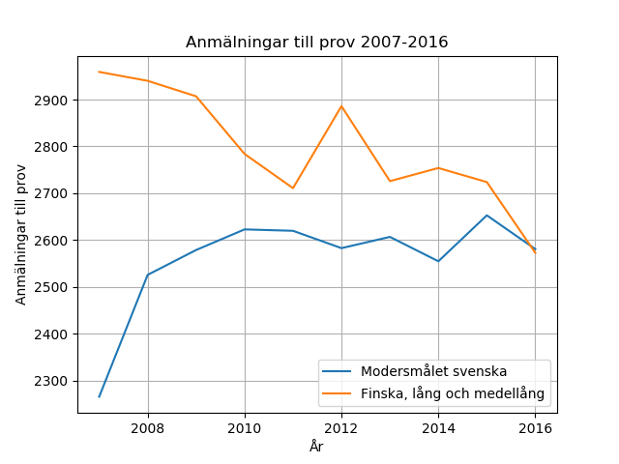
Test registrations 2007-2016
Test registrations
Swedish, mother tongue
Finnish, second national
language, advanced and
intermdiate
Year
Data source: The Matriculation Examination Board (2017)

Slide 6
CAT
Communication Accommodation Theory
We adjust our speech both in regard to speed, vocabulary and the actual language we choose
Communication is bound to social context

Slide 7
How about the web?
No present second interlocutor
Webpages are mostly a medium for one way communication, with some possibilities for two way communication through chat windows and different forms
A Global Village?

Slide 8
Method
Earlier research has focused on analyzing server logs and conducting surveys with self evaluation elements
Observation by recording
Screen capture or screen cast
Annotation tools
Comfort selection of young people and young adults in and around Helsinki

Slide 9
Method - data gathering
Schools and educational institutions in the Helsinki area
Sample:
  Sample size N=36
  Women: 21, men 15
  All participants have grown up in the
  area or have lived there for some time
  (at least 2,5 years the last 5 years)
  Participants were born between
  1995 - 2000

Slide 10
Webpages
Ikea, Clas Ohlson – Swedish private actors
Stockmann, Fazer – Finnish private actors
Reittiopas (indirectly), Vr.fi – Finnish official actors

Slide 11
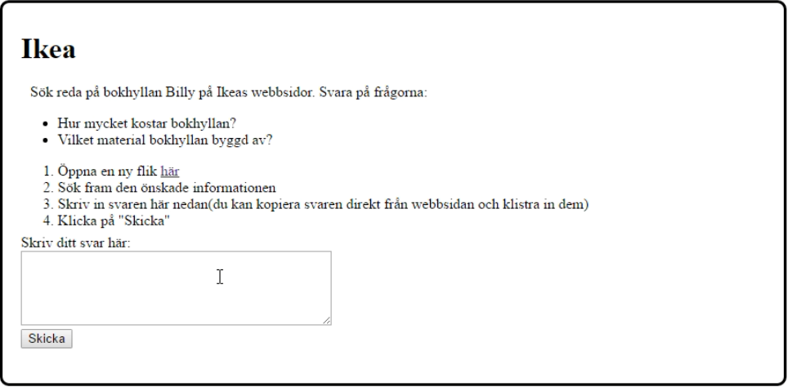
Method – the test

Slide 12
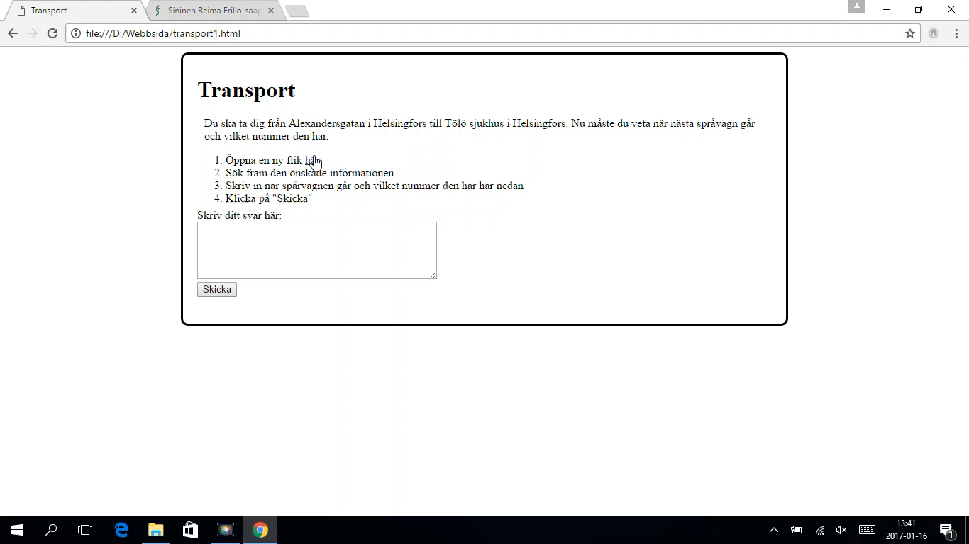
Movavi Screen Capture

Slide 13
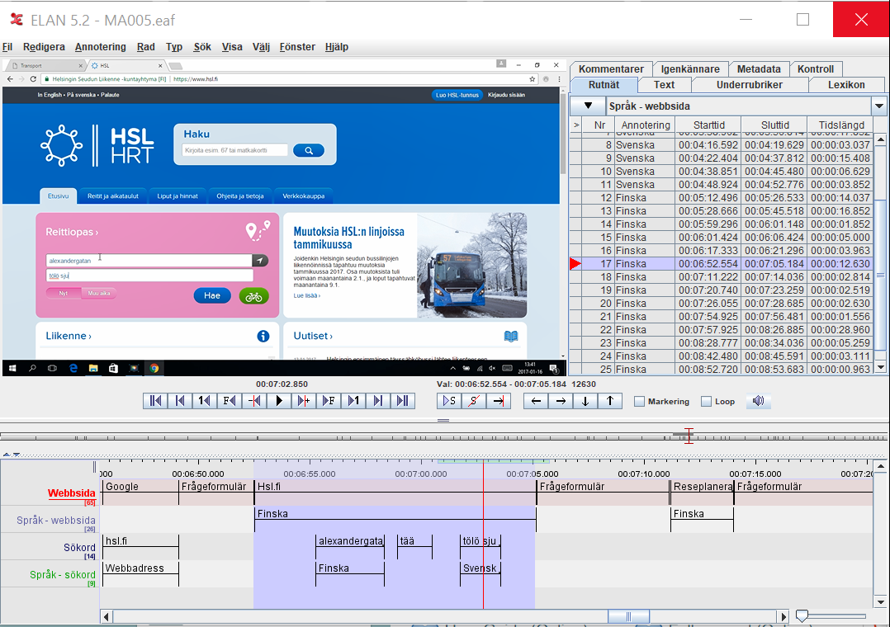
ELAN - annotation

Slide 14
Questionnaire
Identity
Proficiency in Swedish and Finnish
Self report: How much Swedish/Finnish they use on different pages
With whom do they speak which language? (Family, friends etc.)

Slide 15
Analysis
SPSS
Checking for correlations
Sum variables were created
  Swedish identity
  Swedish proficiency
  Finnish identity
  Finnish proficiency
  Self evaluation: preferred language
  Measured time (Without Stockmann and Ikea)

Slide 16
 | Proficiency in Swedish | Finnish identity | Proficiency in Swedish | Reported language | Measured time
Swedish identity | .091 | .323 | .230 | -.238 | -.123
Proficiency in Swedish |  | -.233 | .244 | .413* | -.144
Finnish identity |  |  | .505** | -.537** | -.333*
Proficiency in Finnish |  |  |  | -.465** | -.369*
Reported language use |  |  |  |  | .121
Measured time
Note.
* p < .05
** p < .01

Slide 17
Results
The results show that proficiency in the dominant language (Finnish) in society plays a part in which language are chosen by minority language speakers. A lack of correlation between identity and language choice may mean the choice of language is more of the pragmatic sort on the internet, where internet users don’t have to take an interlocutor in to consideration.

Slide 18
Thank you!

